Slide 1

Chapter 8
Communication
in Groups and Teams

Slide 2
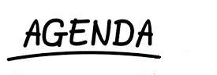
Groups & Teams
Limitations and Strengths of Groups
Small Groups
Digital Media and Group Communication
Effective Communication in Groups
Leadership
Conflict

Slide 3

Defining Groups
Three or more people who interact over time, are interdependent, and follow shared rules of conduct to reach a common goal
Corepics VOF/Shutterstock.com

Slide 4
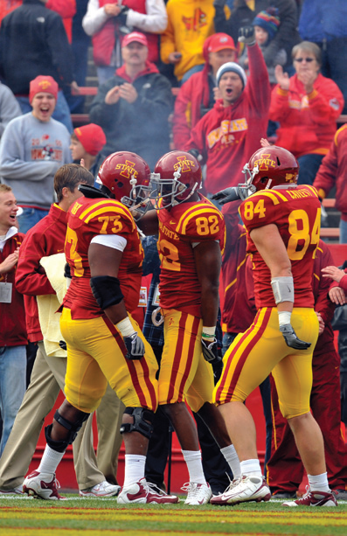
Defining Teams
A special kind of group characterized by different and complementary resources of members and a strong sense of collective identity
David K Purdy/Getty Images Sport/Getty Images

Slide 5
Potential Limitations of Groups
Time
Groups take time to develop norms and complete tasks
Conformity pressures
Majority has an opinion different than the minority
One member has greater power than other members
Reduced individual responsibility
Social loafing
Have you ever experienced conformity pressures in a group?

Slide 6

Potential Strengths of Groups
Greater resources
Greater thoroughness
Synergy
Greater creativity
Greater commitment
Yellow Dog Productions/Photodisc/Getty Images

Slide 7

Features of Small Groups
Cohesion
Groupthink
Group size
Power structure
Power over
Power to
Social climbing
van Hunter/Jupiter images

Slide 8
Five Bases of Power
Reward
Coercive
Legitimate
Expert
Referent

Slide 9
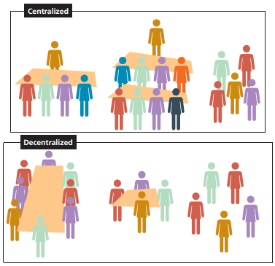
Features of Small Group (cont’d)
Interaction patterns
Centralized: most communication is funneled through one or two people
Decentralized: communication is more balanced and thus more satisfying.
Cengage Learning

Slide 10
Group Norms
Standardized guidelines that regulate how members act and how they interact with each other
Consider what is appropriate or inappropriate
Consider what is lawful or unlawful
What happens to people who breach group norms? Canadian society? Other societies?

Slide 11
Digital Media and Group Communication
Virtual teams operate through virtual conferences or computer networking
Challenges include
Limited nonverbal cues
Constraints on building relationships and group climate

Slide 12
Participate constructively
Task communication
Focuses on giving and analyzing information and ideas
Procedural communication
Focuses on ordering ideas and coordinating members
Climate communication
Focuses on creating and sustaining an open and engaged atmosphere
Egocentric communication
Unconstructive group contribution that block others and calls for attention to oneself

Slide 13
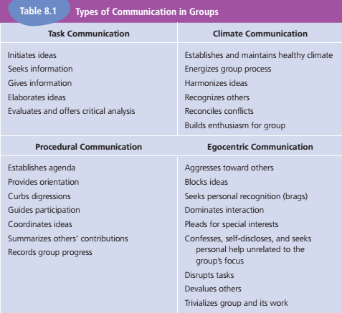
Types of Communication in Groups
Cengage Learning

Slide 14
Guidelines for Communicating in Groups and Teams
Provide leadership
Leadership: a set of communication functions that establishes a good working climate, organizes group processes, and ensures that discussion is substantive
Leadership Approaches

Slide 15

Guidelines for Communicating in Groups and Teams (cont’d)
Manage conflict constructively
Disruptive conflict
Constructive conflict
wavebreakmedia ltd/Shutterstock.com

Slide 16
Summary
Definition of a Group
Conflict
Definition of a Team
Chapter 8
Leadership
Limitations
Power
Strength

